Slide 1
Online Book Store
By Md.Rafiul Alam Durjoy

Slide 2
Table of
What is online book store?
Objectives
Tools Used
Modules
ER-Diagram
Screen Shots
Advantages
Future
Contents

Slide 3
What is Online Book Store?
Online Book Store is an online web application where the customer can purchase books online.

Slide 4
Objectives
The main objective of Online Book Store is to provide an essence of online book store via a simple and yet powerful medium.
The project has been designed to simulate the working of an actual online book store.

Slide 5
Tools Used
Microsoft Visual Studio
Hyper Text Markup Language
Cascading Style Sheets

Slide 6
Modules
A home page with product catalog
Search
Advanced Search
Book Description
Shopping Cart
Managing user accounts

Slide 7
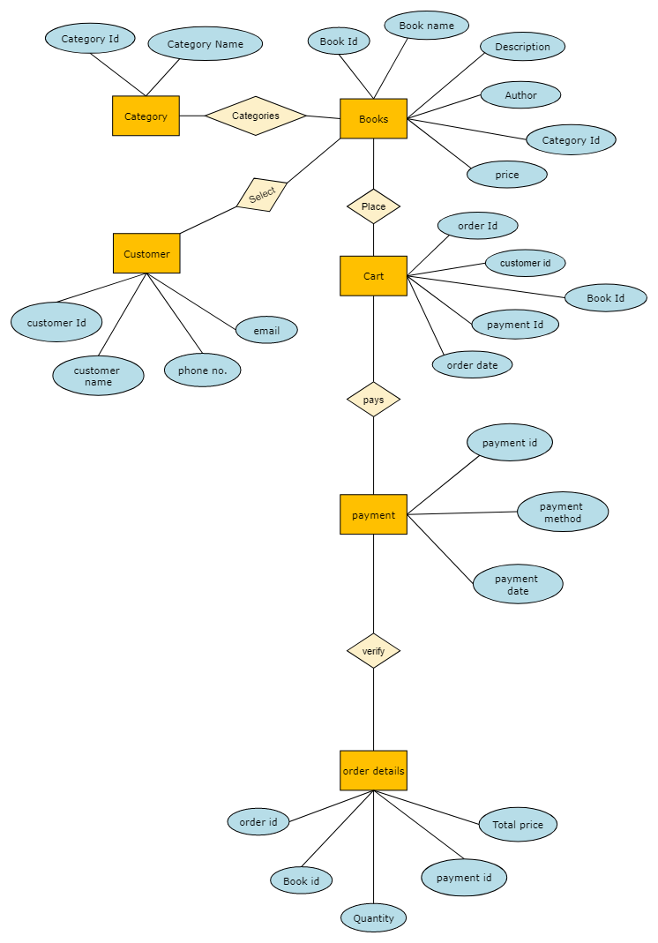
ERD

Slide 8
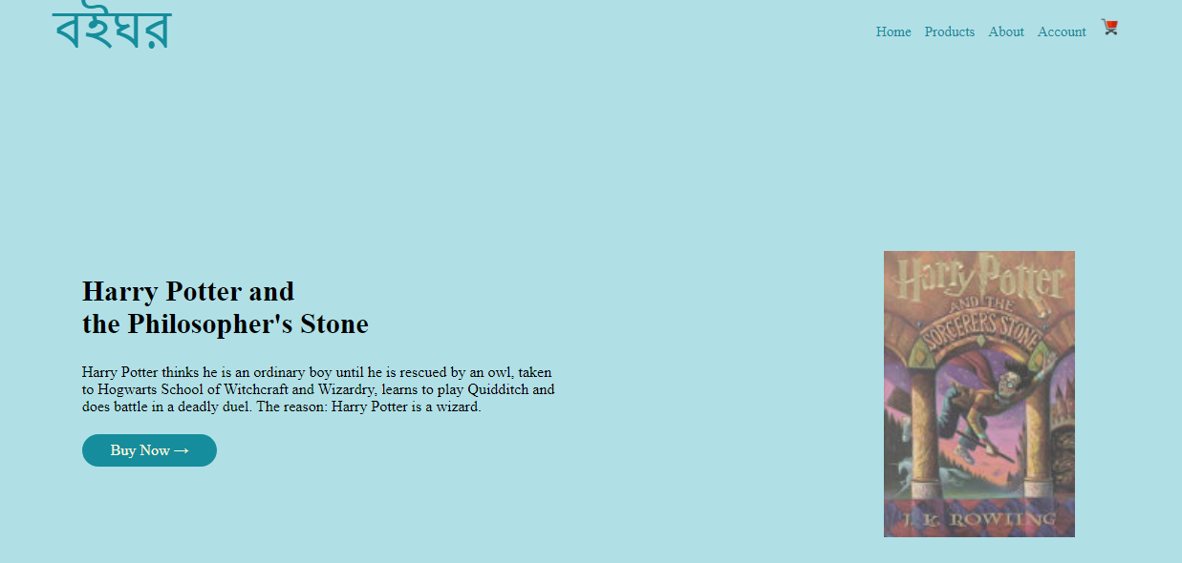
Screen Shots

Slide 9
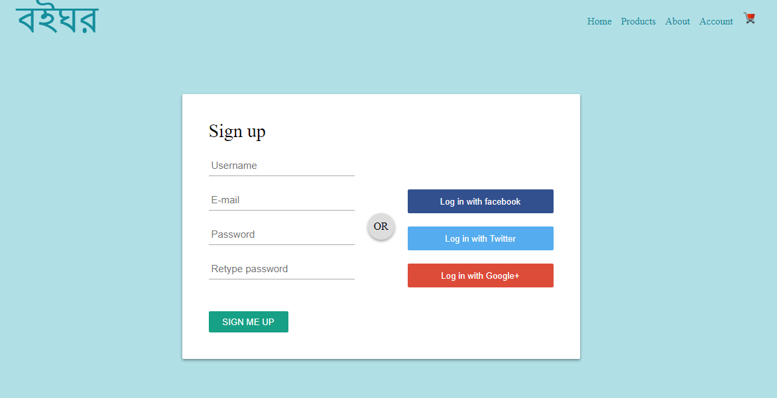
Screen Shots

Slide 10
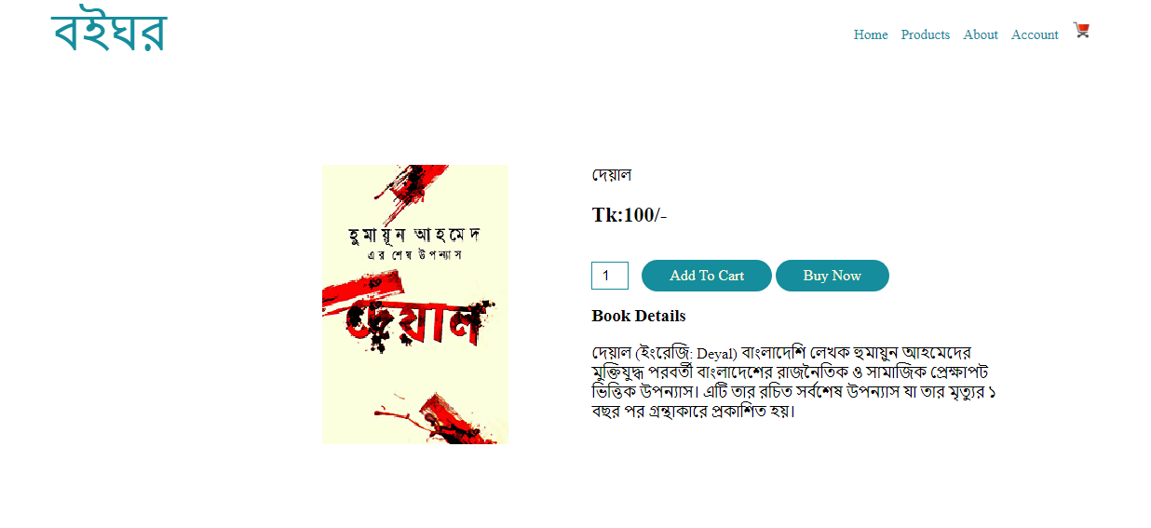
Screen Shots

Slide 11
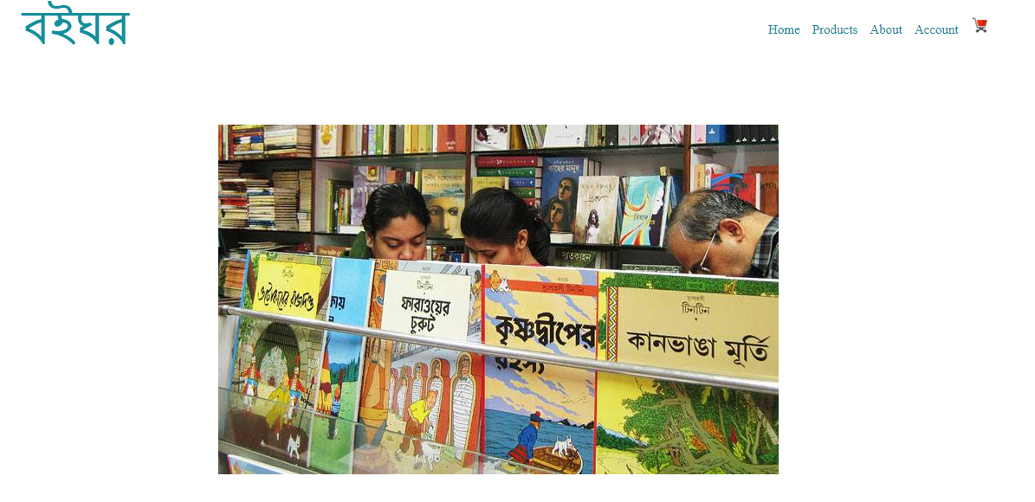
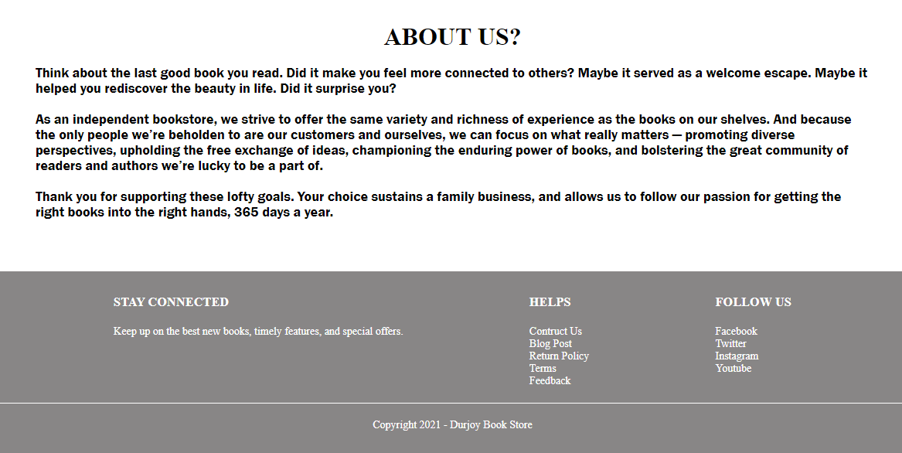
Screen Shots

Slide 12
Advantages
Cost saving
Time saving
Fast purchasing
View books of all categories

Slide 13
Future
Implement backend using php. Add a database using mysql.

Slide 14
Thank You

